Slide 1

Forecasting U.S. Energy Consumption by Source
A Time-Series Analysis for Renewable and Biomass Energy Consumption
Group 4
Akanksha Rambhad
Subaranjana Giridharan
Suneri Airkar
Vyshali Poola

Slide 2



Project Overview & Objectives
This project aims to forecast monthly U.S. energy consumption for key renewable sources. We focus on Total Renewable Energy Consumption and Biomass Energy Consumption.
Forecasting Goal
Modeling Goal
Actionable Insights
Predict the next 12 months of renewable and biomass energy consumption.
Compare Holt’s Winters Exponential Smoothing, Seasonal Regression, Seasonal ARIMA and Deseasonalization based on forecast accuracy.
Improved forecasts can support planning around renewable supply, demand, and policy evaluation.

Slide 3

Data Foundation
We use monthly U.S. energy data from the U.S. Energy Information Administration (EIA), downloaded from the EIA open-data portal and organized in the file Energy_Consumption_Production.xlsx. The dataset spans 379 monthly observations, measured in trillion BTUs, allowing us to study long run trends and seasonal patterns.
Primary Source
U.S. Energy Information Administration (EIA)
Dataset
Energy_Consumption_Production.xlsx
Variables of Interest
Renewable Energy Consumption
Biomass Energy Consumption
Data Partitioning
Training set: 90%
Test set: 10%
We also experimented with 80:20 and 70:30 splits to check model stability.

Slide 4
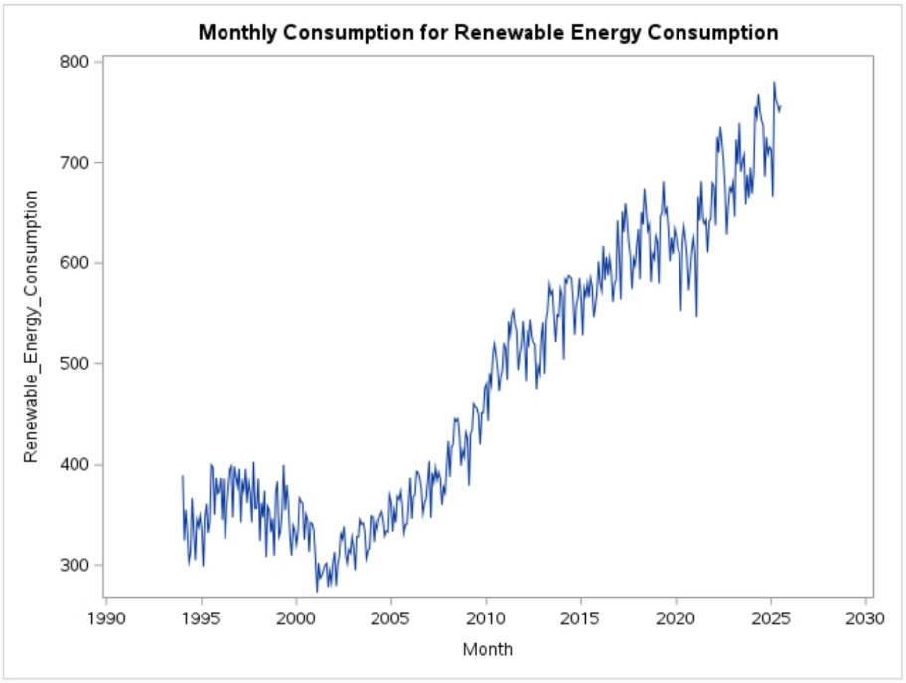
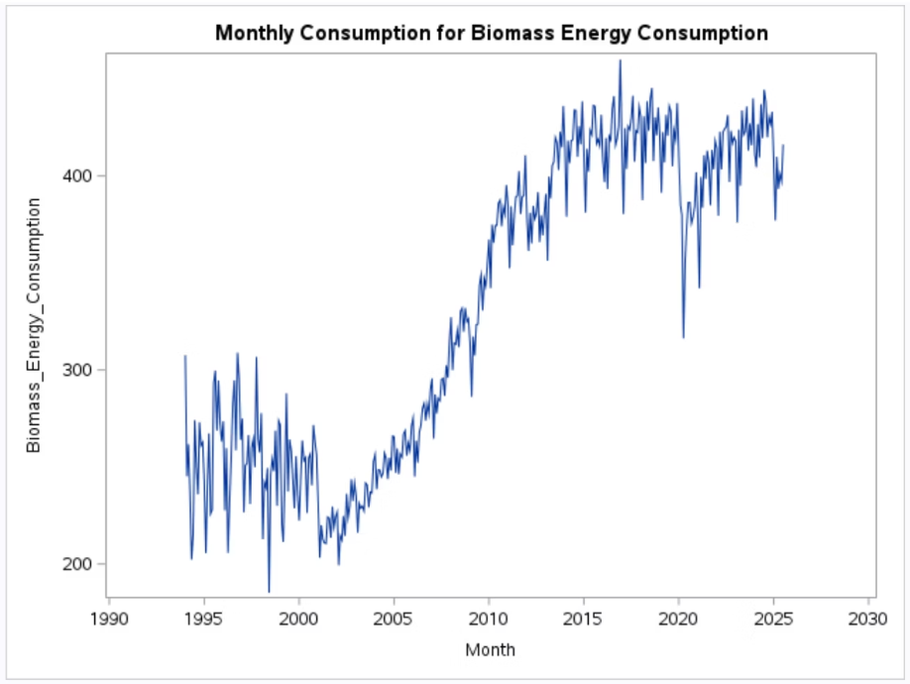
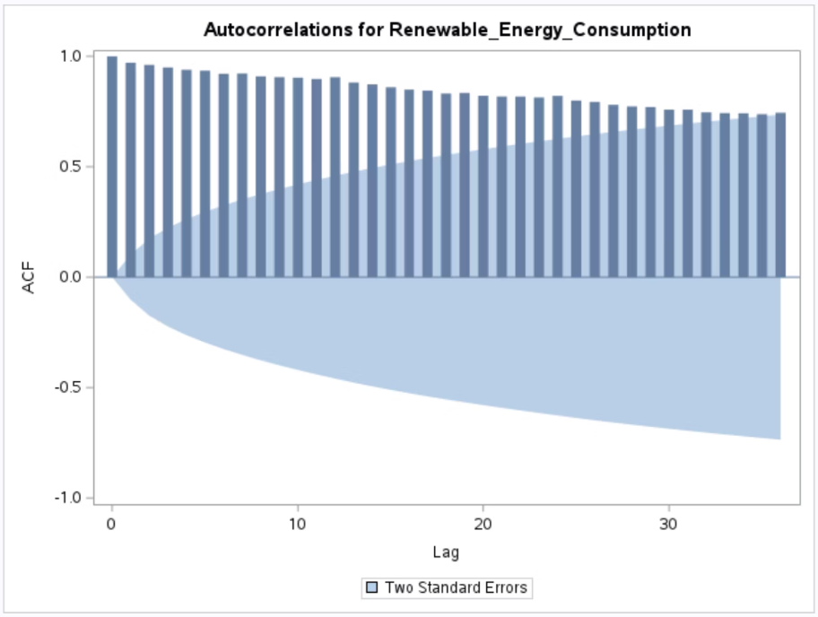

Time-series and ACF Plot
Renewable_Energy_Consumption
Biomass_Energy_Consumption

Slide 5

Model Development: A Multi-faceted Approach
1
Holt's Winters Exponential Smoothing
2
Multiple & Non-linear Regression
3
Seasonal ARIMA
4
Deseasonalization

Slide 6
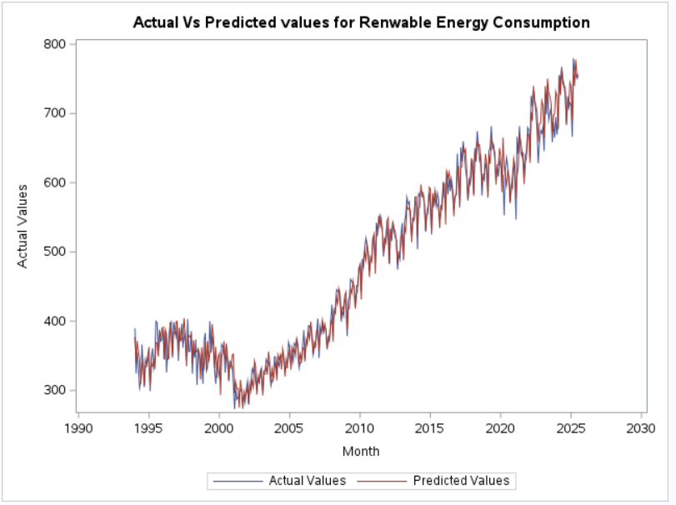
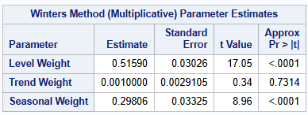
Holt's Winters Exponential Smoothing
Variable: renewable_energy_consumption
Winter’s Multiplicative Method
Measures of Model Fit and Model Accuracy
Model Fit
Model Accuracy
MAPE
2.795 %
2.629 %
MAE
11.807
18.205
MSE
252.25
500.56

Slide 7
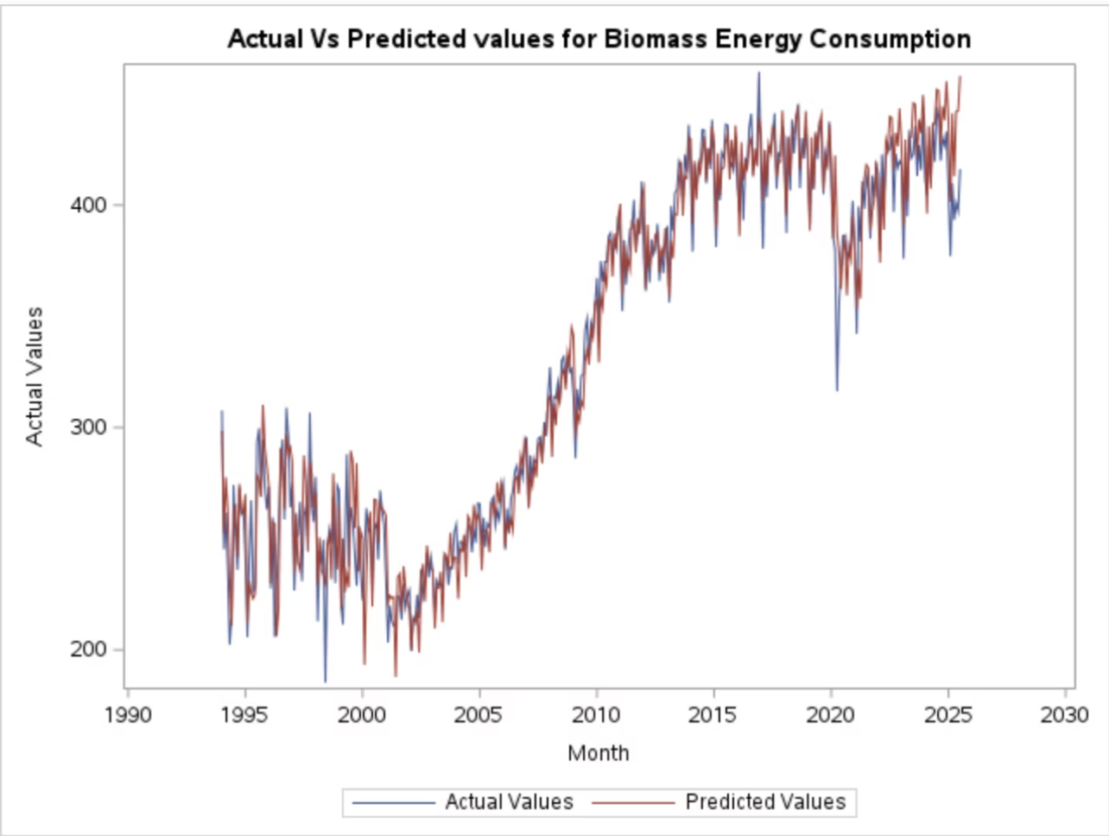
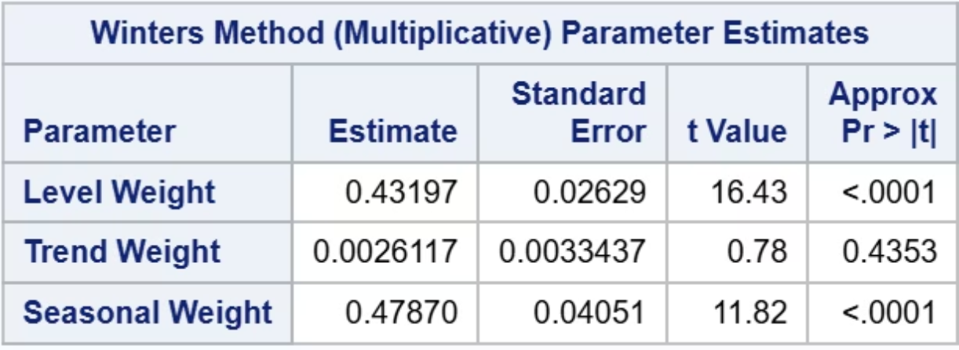
Holt's Winters Exponential Smoothing
Variable: Biomass_Energy_Consumption
Multiplicative Winter's Method
Measures of Model Fit and Model Accuracy
Model Fit
Model Accuracy
MAPE
3.33 %
3.70 %
MAE
9.57
15.24
MSE
189.71
352.40

Slide 8
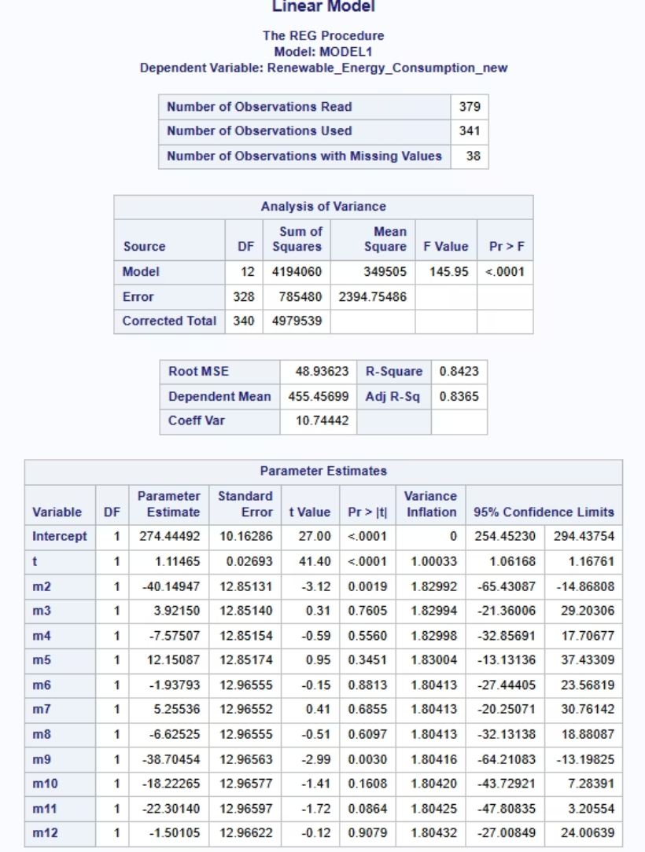
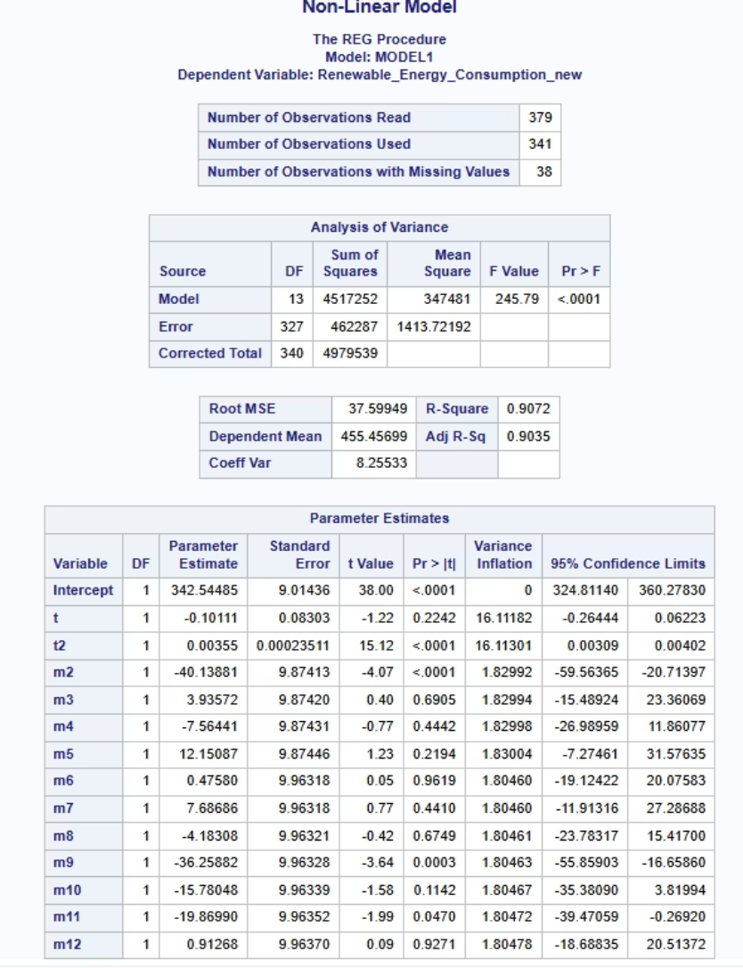
Multiple & Non-Linear Regression
Variable: renewable_energy_consumption
Multiple Regression
Non-Linear Regression
​
Equation of the Fit line:
𝑦̂ = 274.44492 +1.11465t −40.19497m2 +3.92150m3 −7.57507m4 +12.15087m5 −1.93793m6 +5.52536m7 −6.62255m8 −38.70454m9 −18.22265m10 −22.33014m11 −1.51015m12​
​
Equation of the Fit line:
𝑦̂ = 342.544855 −0.101111t +0.00355t2 −40.13881m2 +3.39572m3 −7.56441m4 +12.15087m5 −7.01177m6 +7.68686m7 −4.18308m8 −36.25828m9 −15.78040m10 −19.86990m11 +0.91268m12​

Slide 9
Model Fit & Accuracy
Linear
Non-linear
Model Fit
Model Accuracy
Model Fit
Model Accuracy
MAPE
10.36%
5.67%
MAPE
7.41%
7.60%
MAE
40.58
41.02
MAE
31.35
53.08
MSE
2303.46
2151.66
MSE
1335.68
3280.13
Since the linear model shows lower MAPE, MAE and MSE on the Model Accuracy data, it generalizes better than the non-linear model, so it is chosen as the preferred forecasting model.

Slide 10
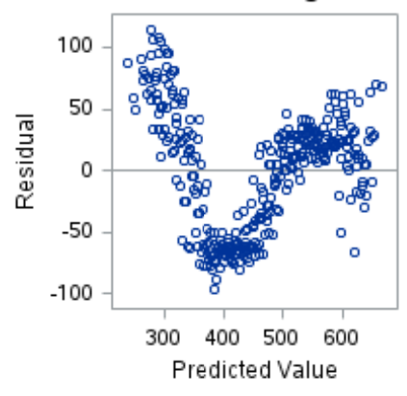
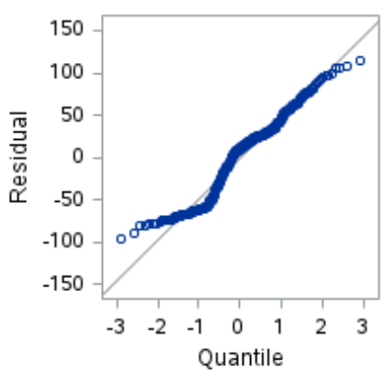
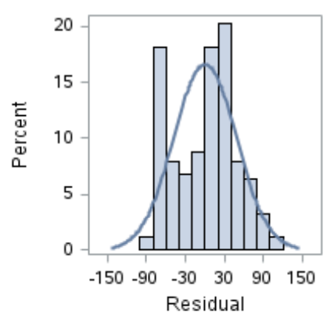
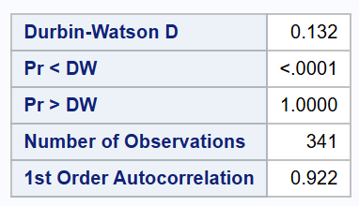
Model Assumptions
Assumption:
Q-Q plot follows the straight line and histogram is roughly bell-shaped, so normality is satisfied.
The residuals do not show an even spread and displays a noticeable pattern, indicating that the constant variance assumption is not satisfied.
Pr < DW p-value < 0.05, indicating positive autocorrelation and therefore the errors are not independent.

Slide 11

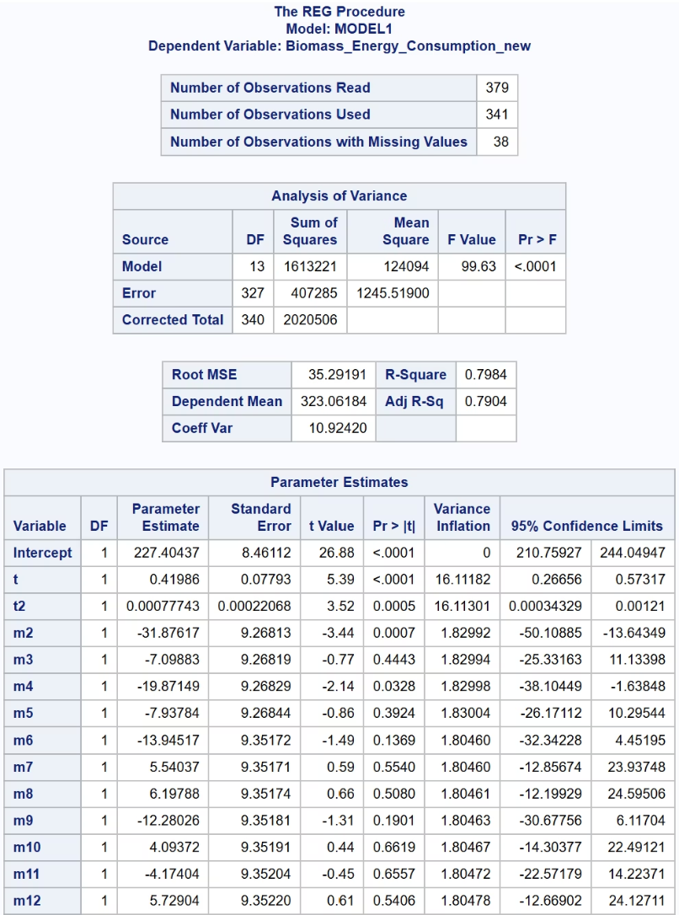
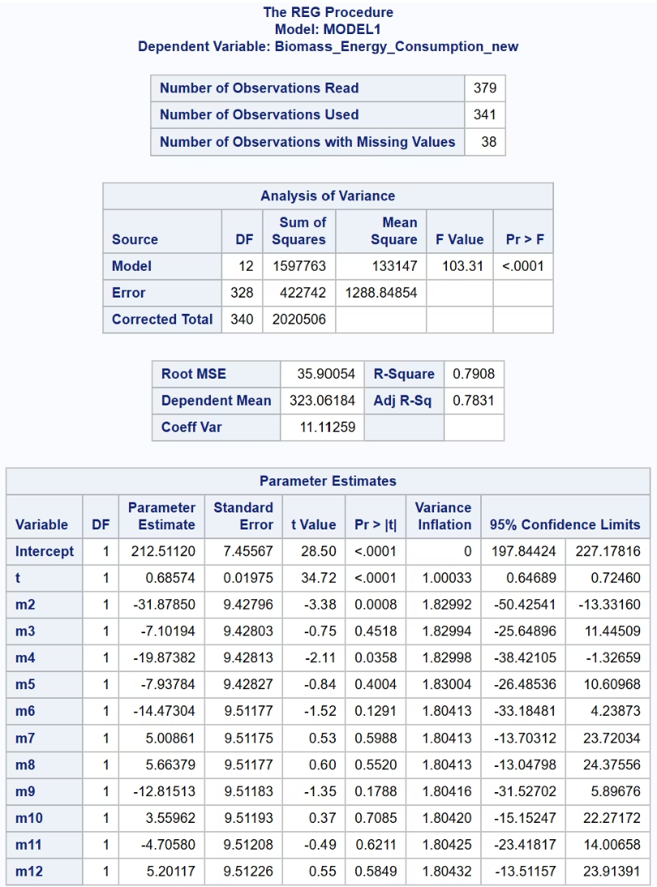
Multiple & Non Linear Regression
Variable: biomass_energy_consumption
Multiple Regression
Non-Linear Regression
Equation of the fit line :
𝑦̂ = 212.51120 + 0.68574(t) - 31.87850(m2) - 7.10194(m3) - 19.87382(m4) - 7.93784(m5) - 14.47304(m6) + 5.00861(m7) + 5.66379(m8) - 12.81513(m9) + 3.55962(m10) - 4.70580(m11) + 5.20117(m12)
Equation of the fit line :
𝑦̂ = 227.40437 + 0.41986(t) + 0.00077743(t²) - 31.87617(m2) - 7.09883(m3) - 19.87149(m4) - 7.93784(m5) - 13.94517(m6) + 5.54037(m7) + 6.19788(m8) - 12.28026(m9) + 4.09372(m10) - 4.17404(m11) + 5.72904(m12)

Slide 12
Model Fit & Accuracy
Variable: biomass_energy_consumption
Linear Regression
Non-Linear Regression
Model Fit
Model Accuracy
Model Fit
Model Accuracy
MAPE
10.244%
8.657%
MAPE
9.686%
13.578%
MAE
30.506
35.742
MAE
29.612
56.235
MSE
1239.714
1466.161
MSE
1194.383
3417.501
In terms of fit, the second model is better where all three error measures are slightly lower. In terms of accuracy, the first model is better with lower values for all three measures. Therefore, the first model is better.

Slide 13
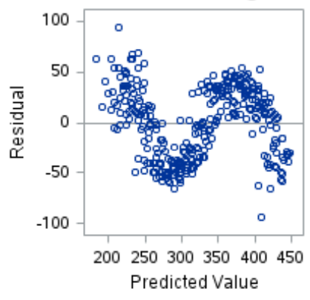
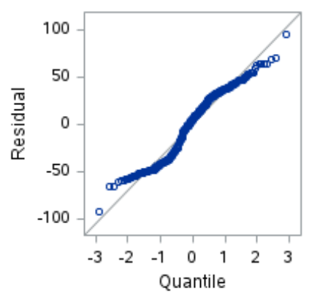
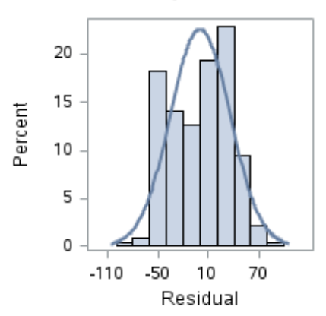
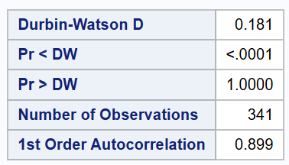
Model Assumptions
Assumptions:
Q-Q plot follows the straight line and histogram is roughly bell-shaped, so normality is satisfied.
The residuals displays a noticeable pattern, indicating that the constant variance assumption is not satisfied.
Pr < DW p-value < 0.05, indicating positive autocorrelation and therefore the errors are not independent.

Slide 14
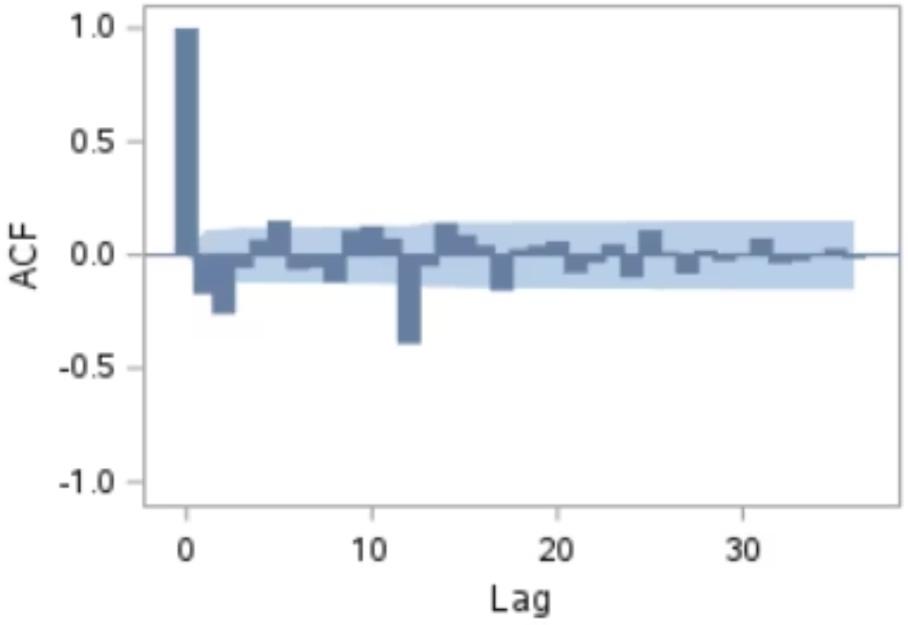
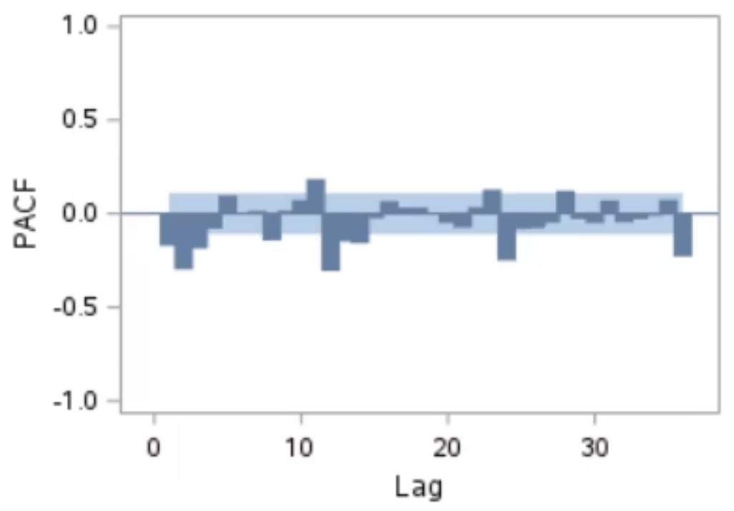
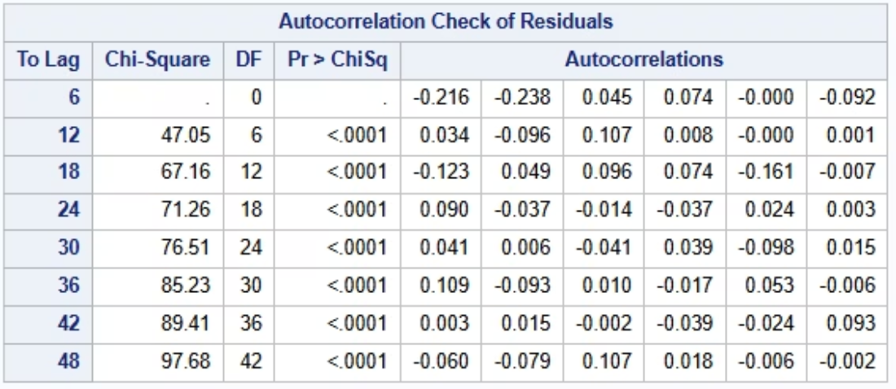
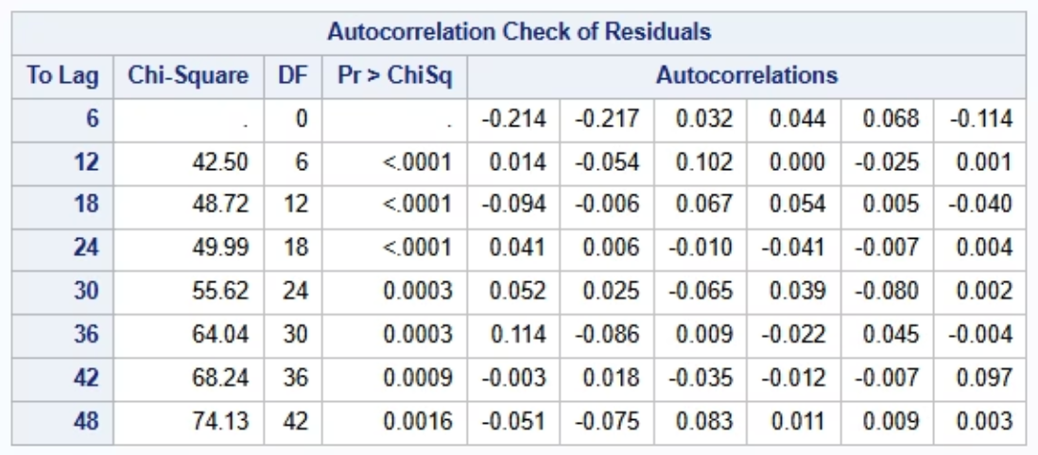
Seasonal ARIMA
Variable: renewable_energy_consumption
Possible Models Tried:
ARIMA(11,1,5)(3,1,1)
ARIMA(14,1,17)(3,1,1)
ARIMA(3,1,0)(3,1,1)
ARIMA(3,1,2)(3,1,1)
Model -1 ARIMA(11,1,5)(3,1,1)
Model -2 ARIMA(14,1,17)(3,1,1)
None of the ARIMA models passed the residual independence tests, so the model assumptions are not met. This makes ARIMA a weak fit for our dataset.

Slide 15
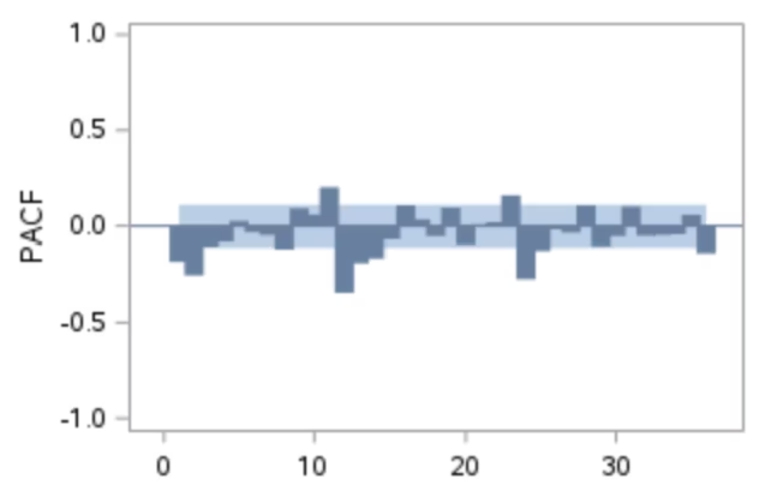
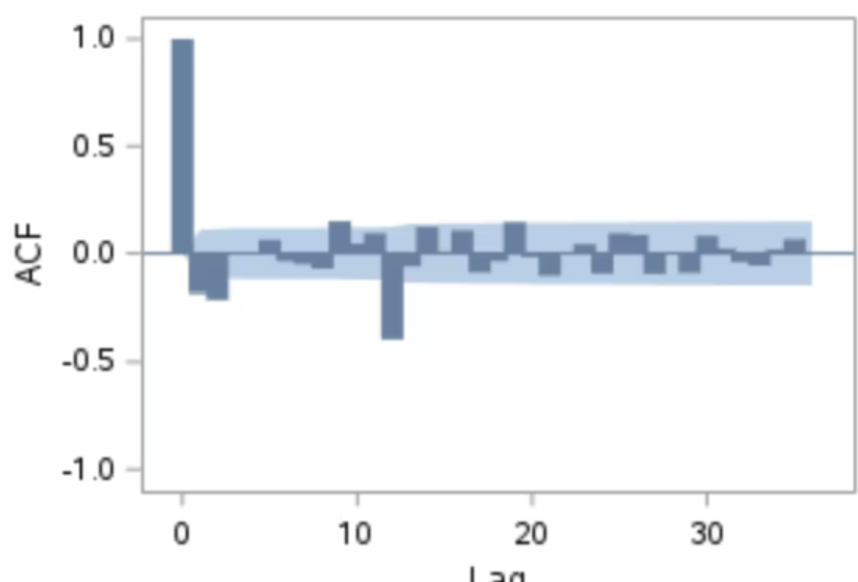
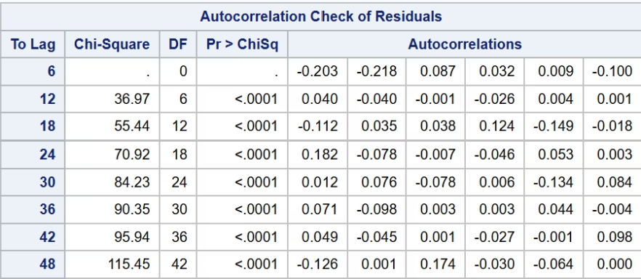
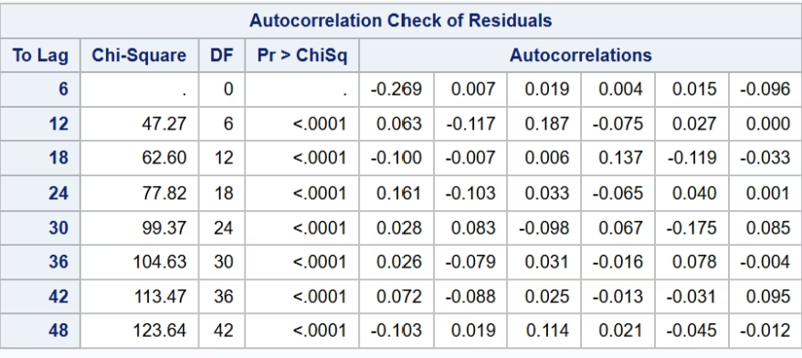
Seasonal ARIMA
Variable: Biomass_Energy_Consumption
Possible Models Tried:
ARIMA(2,1,2)(3,1,1)
ARIMA(14,1,9)(3,1,1)
ARIMA(11,1,2)(3,1,1)
ARIMA(2,1,9)(3,1,1)
Model -1 ARIMA(11,1,9)(3,1,1)
Model - 2 ARIMA(14,1,2)(3,1,1)
None of the ARIMA models passed the residual independence tests, so the model assumptions are not met. This makes ARIMA a weak fit for our dataset.

Slide 16
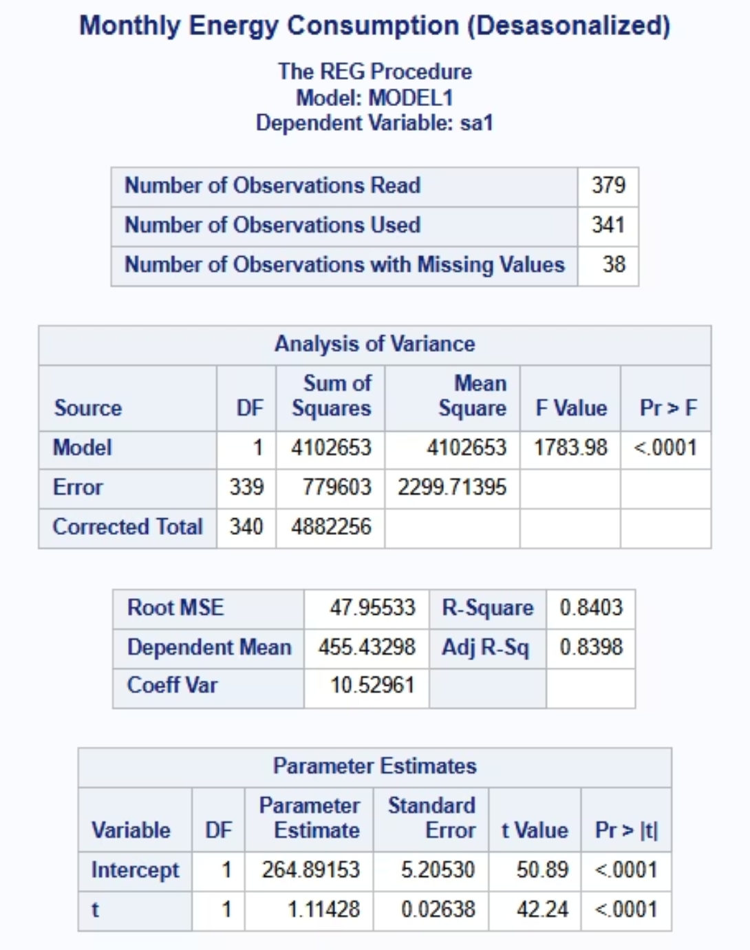
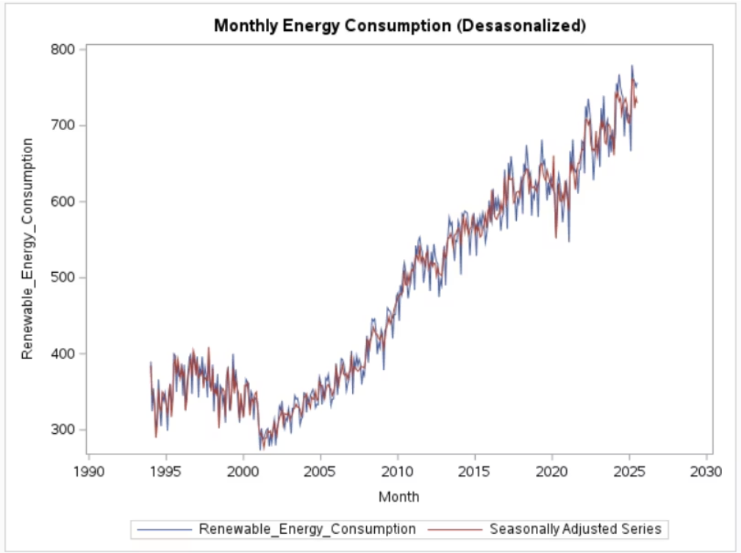
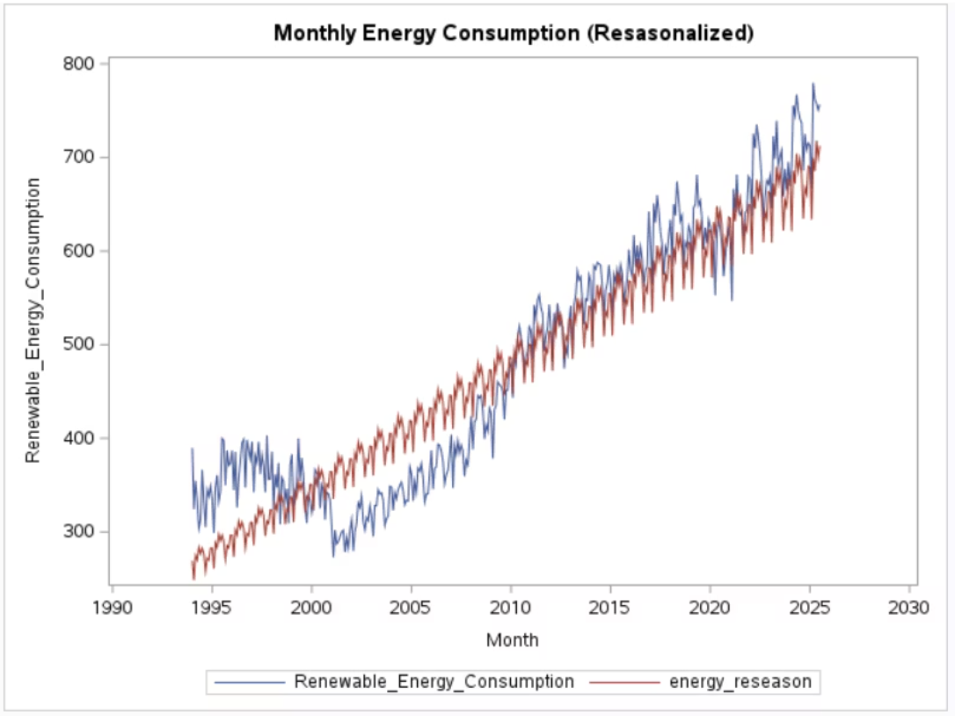
Deseasonalization
Renewable Energy Consumption
Measure of Model Fit and Accuracy
Model Fit
Model Accuracy
MAPE
10.243%
8.667%
MAE
30.486
35.904
MSE
1240.240
1476.528
Equation:
𝑦̂ = 264.891 + 1.11t

Slide 17
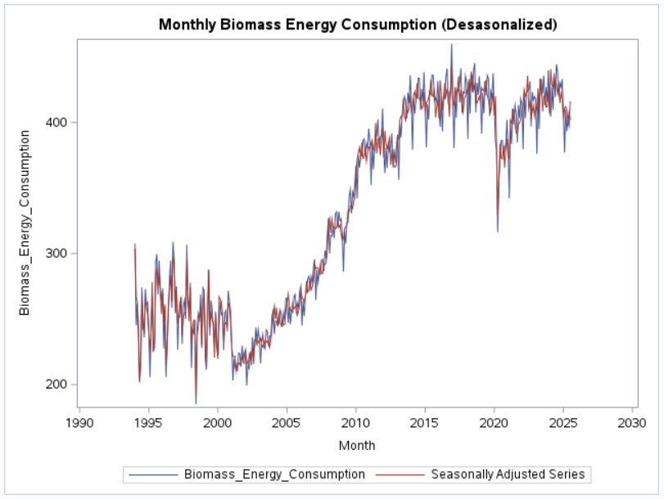
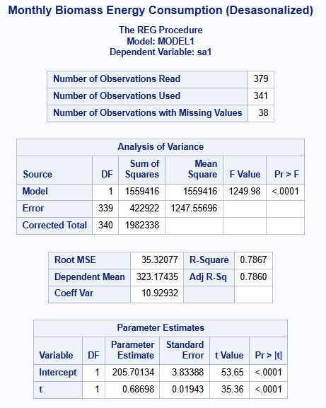
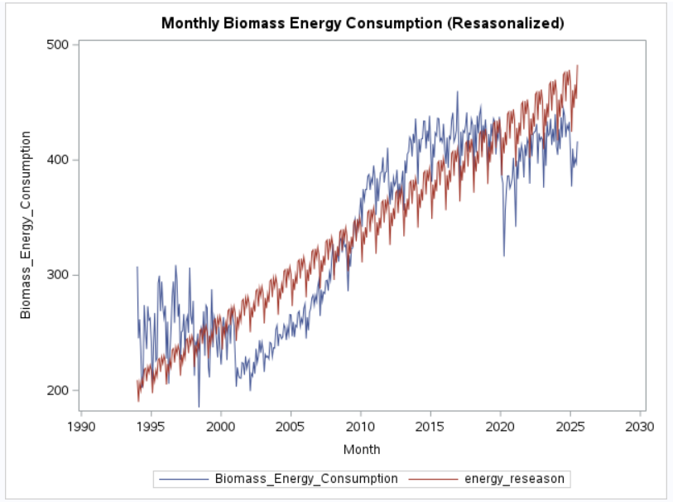
Deseasonalization
Biomass Energy Consumption
Measure of Model Fit and Accuracy
Model Fit
Model Accuracy
MAPE
10.360%
5.642%
MAE
40.606
40.536
MSE
2286.2
2039.6
Equation:
𝑦̂ = 205.701 + 0.686t

Slide 18
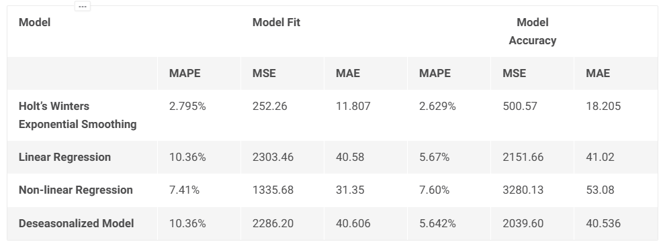
Comparison of All the models
Renewable Energy Consumption
Holt’s model performs best overall, with the lowest errors.
It is simple and parsimonious, making it the preferred forecasting model.

Slide 19
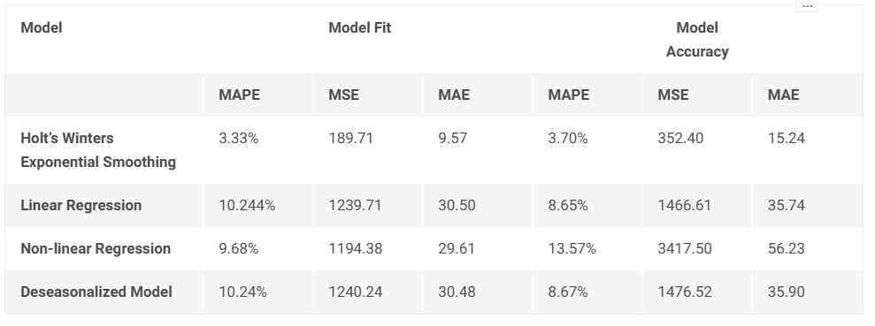
Comparison of All the models
Biomass Energy Consumption
Holt’s model performs best overall, with the lowest errors.
It is simple and parsimonious, making it the preferred forecasting model.

Slide 20

Project Outlook: Empowering Future Energy Decisions
Holt’s model delivers the most accurate and reliable forecasts.
A 12-month forecast has been generated to project upcoming consumption trends.
These insights support better planning for future renewable energy needs.

